Slide 1
Crime Trends in NYC during the COVID-19 Pandemic
Group 6: Claudia Canamas, Ashton Smith, Ken Tseng, Edmund Annobil, Jared Roussel
Aug 3, 2021

Slide 2
Background and Research Questions
As crime analysts for the New York State Bureau of Investigations, our team is interested in analyzing crime statistics during the initial phase of the COVID-19 pandemic.
During this time, NYC peaked at 6,000 new daily COVID cases. Also during this time, NYC was experiencing an average of about 1,300 daily crime reports in the city. We were interested in exploring a trends among these issues.
Are the growth in COVID-19 cases correlated with a rise or decrease in crime within the city?
Is the correlation visible in the majority of types of crime (e.g. burglary vs assault)?
What other events occurred in this Feb 2020 - Sep 2020 time period that could explain potential outliers in NYC crime data?
Notes:
Claudia
Did the crime statistics follow the COVID cases geographically?
Is the correlation stronger in certain NYC boroughs?
Did the pandemic affect certain crime statistics more than others?

Slide 3
Data Cleaning & Preparation
Merge Crime CSV & COVID data files
NYC Crime Data | Data from Feb - Sept 2020
NYC COVID Data | Data for Feb - Sept 2020
Google Geocode API | Returns coordinates for each borough
Created new DF and reorganized columns
Create a CSV output of cleaned data
https://data.cityofnewyork.us/Health/COVID-19-Daily-Counts-of-Cases-Hospitalizations-an/rc75-m7u3
https://data.cityofnewyork.us/Public-Safety/NYPD-Complaint-Data-Historic/qgea-i56i
Notes:
Ken
Data Cleaning:
Merging NYC crime and NYC covid cases data.
Dropping unnecessary data and columns.
LOC function to align dates across data sources and DFs
Standardized date format in merged DF
Replaced missing data with ‘N/A’
Create a CSV output of cleaned data.
Importing CSV file and started analyzing the data.
NYC Crime Data | Contains historic crime complaint data for the city
Data from Feb - Sept 2020
NYC COVID Data | Contains case numbers per borough
Data for Feb - Sept 2020
Google Geocode API | Returns coordinates for each borough
Data Cleaning and Preparation
Merge 5 separate CSV files into single file for processing; merge with COVID data file
Created new DF and dropped unnecessary columns; renamed and reorganized columns
LOC function to align dates across data sources and DFs
Standardized date format in merged DF
Replaced missing data with ‘N/A’
Create a CSV output of cleaned data

Slide 4
Data Aggregation
Per Day
Covid Case Count
Daily Crime vs
Daily Covid
Crime Complaints
Merged Dataset of COVID and Crime Statistics
Per Borough
Covid Case Count
Crime Complaints
Type of Crime
Suspect Age
Overall Crime
Demographic
Suspect Race
Notes:
Ken
Project 1 (Slide 2 and Slide 3)
Outline:
Data Aggregation:
Break down to three statistics: Per Day, Per Borough, and Overall Crime.
In “Per Day”, we have two data sets, which are Covid Case Count and Crime Complaints. Also, we looked into the relationship between Daily Crime vs Daily Covid.
In “Per Borough”, we looked into the five neighborhoods, which is Brooklyn, Bronx, Queens, Manhatton, Staten Island for Covid Case Count and Crime Complaints.
In “Overall Crime”, we looked into “Type of Crime” and “Demographics (Suspect Age & Race)”.
Presentation: (my speech)
In data cleaning we merged all five NYC Crime DataSet and COVID-19 Daily Counts of Cases.csv. During data cleaning we dropped unnecessary columns and data. We used LOC function to align dates across data sources and Data Frames, standardized date format in merged Data Frames, and replaced missing data with ‘N/A’.
Afterwards, we exported the clean data as merged_NYC_data.csv.
All data we showed are between Feb/29/20 to Sept/29/20, and below the slide are the links to the sources.
To next slide, we imported the merged_NYC_data.csv. file and started to analyze the data. We divided the data to three types, which is “Per Day”, “Per Borough”, and “Overall Crime”.
In “Per Day”, we analyzed COVID case count and crime complaints. Furthermore, we looked into the relationship in “Daily Crime vs Daily Covid”. In “Per Borough”, we counted the COVID cases and the Crime Complaints in each five neighborhood. Which is Brooklyn, Bronx, Queens, Manhattan, and Staten Island.
In “Over Crime”, we discovered the types of crime and demographic. In demographics, we broke down to suspect age and race.
We tried to find if there’s a correlation between COVID - 19 cases and criminal behavior.

Slide 5
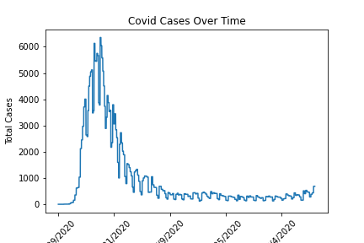
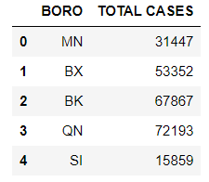
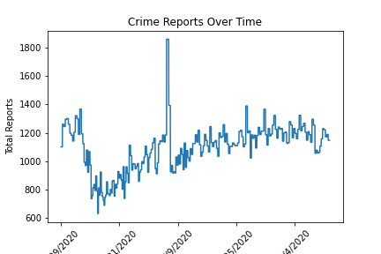
General Covid and Crime Trends in NYC:
Feb 2020 to Sep 2020
Quick Look at the Data brings up questions:
Further investigation into borough with most COVID cases: Queens
Further investigation into steep spike in crime - which borough is contributing to this the most?
Notes:
Ashton
When examining our data, we realized Queens had the most covid cases and wanted to see how that translated into the crime rates. Upon further investigation, the covid line graph for Queens followed the same trend as the overall graph and the crime rate remained consistent. The exception to this, however, was a noticeable dip when covid cases were at its highest, giving Queens a strong correlation between its covid cases and crime reports.
When looking at the crime reports, we noticed a drastic outlier. We then ran this same graph for each borough individually to see if they all followed this trend or if one borough was responsible for this outlier. After doing this, only one borough had a graph that matched this one: Manhattan. Considering the date was at the end of May, this outlier can be linked to the protest happening in Manhattan.

Slide 6
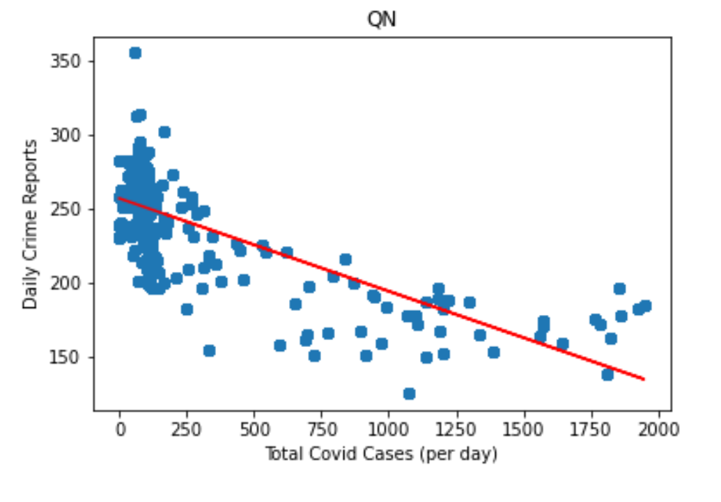
Plots and Analysis | Crime vs COVID
Queens Total Crime vs COVID
Queens had an r-squared = 0.51560
Given what we know about total case counts, it seems that boroughs with higher overall COVID cases experienced a stronger inverse correlation between case counts and crime reports
Crime rates higher when COVID case counts lower ( x < 250),
Refutes original hypothesis stating crime increased during the pandemic
Noticeable uptick in crime rates once COVID cases increase above 1750 cases/day
Notes:
Claudia/Jared
Claudia: QN has Strongest linear correlation between daily covid cases and crime of any NYC borough, followed by Brooklyn and Bronx
Jared: This is supported by the graph presented here. We see crime start to decrease as covid cases increase, supporting a noticeable correlation between crime #s and covid cases. We suspect this is due to lockdown measures NYC put in place to curb the spread of coronavirus.
However, this “peace” did not last forever, as there is a noticeable uptick in crime as covid cases reach a maximum.

Slide 7
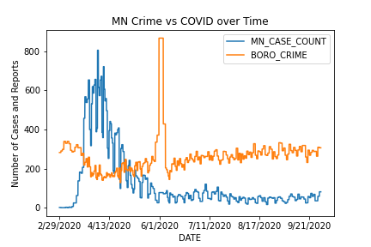
Plots and Analysis | Crime vs COVID
Manhattan Total Crime vs COVID over Time
Crime reports reach inflection point as COVID cases hit a maximum per day
Spike in the Crime Cases represents outlier
Notes:
Jared: Since Queens, Brooklyn and the Bronx had the highest correlation, we wanted to verify that we were not reading our own bias into the data. So we took the borough with a lower r-value and produced a chart of crime vs. covid cases over a period from Feb 2020 to Sept 2020 to see if a similar inflection point was noticed.
As presented here, the trends reappear with crime dropping as covid cases sharply rise. A similar inflection point in seen in the MN data as viewed in the QN data as covid cases reach a maximum point, crime trends reverse and start to rise again. This spike is assumed to be related to the George Floyd protests in the summer of 2020.
The sharp spike in crime represents an outlier in our data but follows the general trend of increasing crime as covid #’s dropped again. This

Slide 8
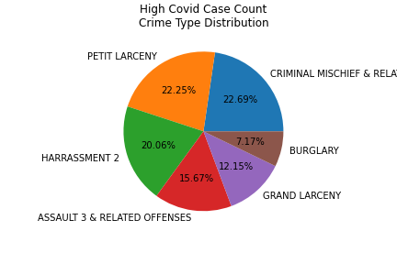
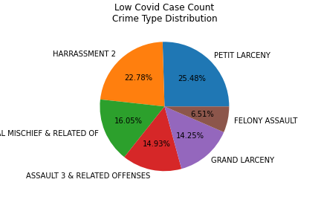
Plots and Analysis | Crime vs COVID
Most Common Crime Categories in Time Period of Interest:
This is how crime distribution varied with COVID case levels
High Covid Case Date: 4/1/2020 // Low Covid Case Date: 9/4/2020
Notes:
Ashton
We wanted to see not only volume of crime as it relates to covid cases but also the types of crime. Here on the left, we see the crime reports on a particularly high covid day (we chose April 1st, 2020). The graph on the right shows crime reports on a particularly low covid day (we chose September 4th, 2020). For the most part, crime type did not change except the crimes that involved other people, such as harassment and assault, did increase slightly as the threat of COVID went down. This could be because more people were out and available to be targets of the crime.

Slide 9
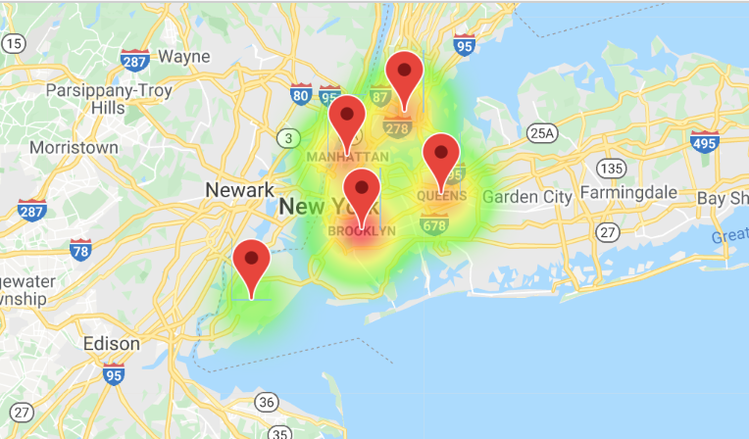
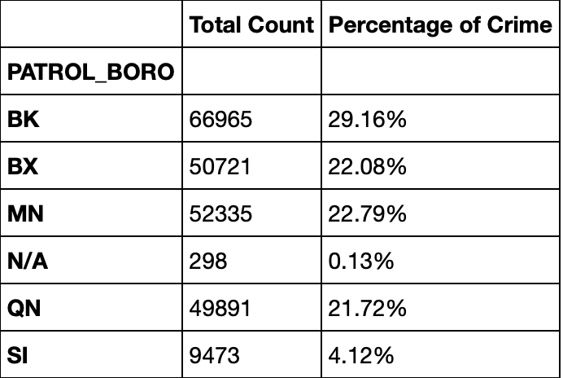
Heatmap | Google API
This heat map depicts the relative crime levels in each NYC borough and provides a geographic perspective.
Notes:
Edmund
Here is a heat map showing a geographic view of the relative crime levels in each borough of NYC. The table also displays crime constituted per borough by total count and percentage of crime.
The overall analysis proves a negative correlation between daily COVID cases & crimes rates in NYC as a whole. The correlation is seen most strongly in boroughs with high COVID cases. The biggest exception observed in the case of Manhattan which had an outlier around June 1st, could probably be as a result of massive protests during that period leading to more criminal complaints.
According to our findings, this analysis disproves the hypothesis that the rise in COVID cases caused an increase in crime rate in NYC. Such information is relevant as it could help the police department make an informed decision on where to allocate their resources and staff during these challenging times.

Slide 10
Questions?
Notes:
Edmund
Any Questions?

